Slide 1
Cloud Security
ENPM665
Robert Dean

Slide 2
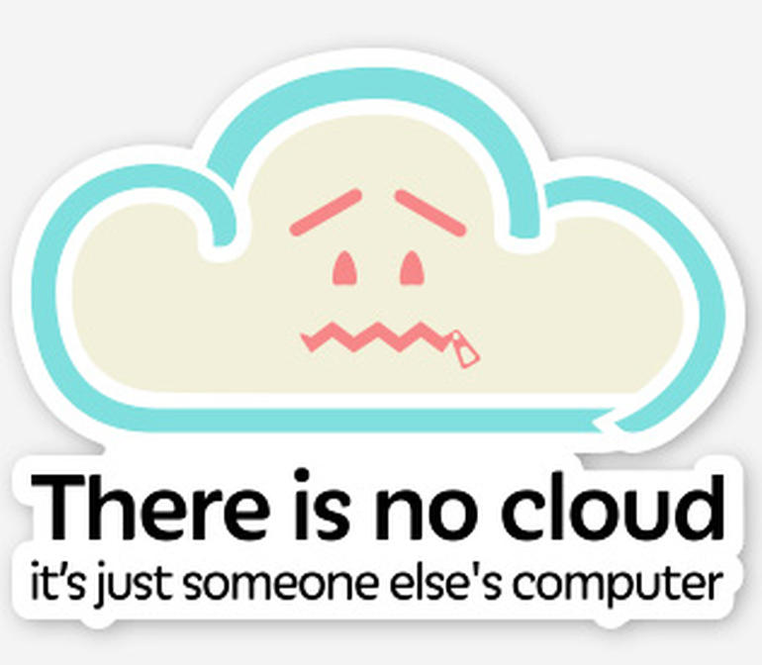

Slide 3
Who am I?
Lead Information Technology Compliance Specialist - Division of IT, UMD
Reviews all new products requested for use/integration on campus
If a system handles your sensitive information on campus, I have audited it
Former auditor for the state of MD

Slide 4
TA
Komal Singh
Komal@umd.edu
Office Hours: Tuesday noon – 1pm and by appointment (all via Zoom)

Slide 5
Note
I do not have any open TA/GA/grader/student employee positions at this time.
If and when I do they will be posted on MAGE’s website and/or I will post about them in ELMS.

Slide 6
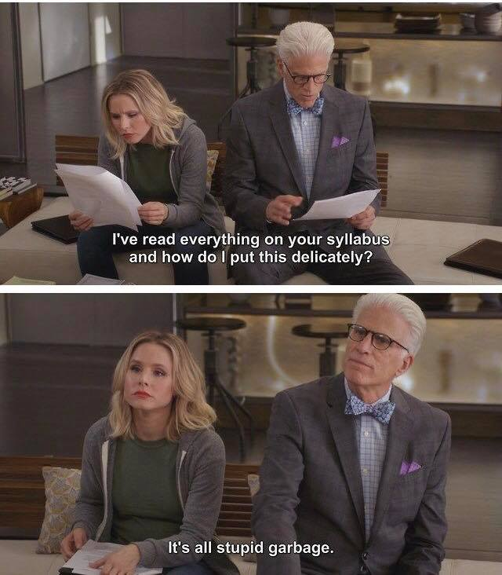

Slide 7
Course schedule
September 1 – December 8
Presentations and assignments will be uploaded to ELMS prior to class
0101 – Thursdays 7 – 9:40pm – JMP 3201
PLEASE ONLY ATTEND THE SECTION YOU ARE REGISTERED FOR!

Slide 8
Attendance
You MUST attend the section you are enrolled in and can NOT attend other sections.
Ex: CY01 section can not attend in person (0101, 0201, or 0301)
If you miss a class you can watch it on demand at any time in ELMS. (should be available a few hours after class is held.)

Slide 9
Attendance
I am not planning to take attendance.
Note for students in section 0101 on an F1 visa, your visa status may be in jeopardy if you do not attend in person. For students on an F1 visa I look forward to seeing you each and every week. 🤗

Slide 10
Office Hours
Tuesdays – noon to 1pm
Zoom links will be posted weekly in Canvas
Also by appointment (online)
I am in the Manokin building

Slide 11
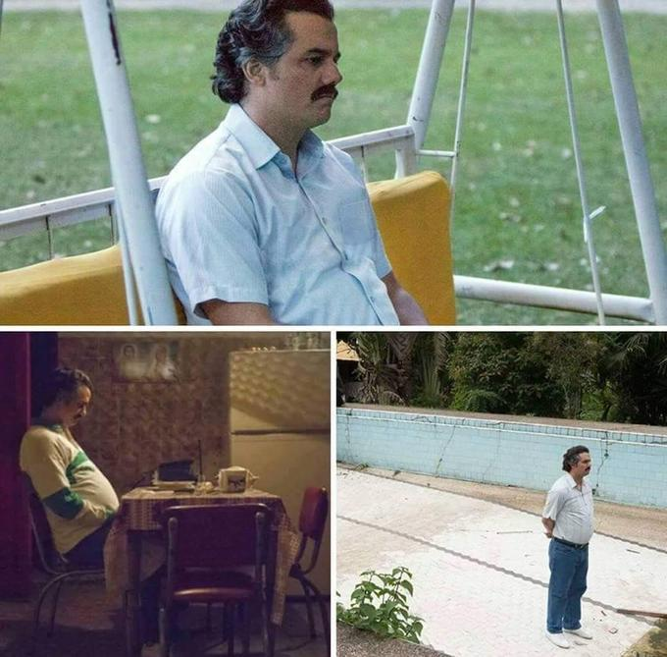

Slide 12
Contact Info
rdean1@umd.edu- Best way to reach me. Please put “ENPM665” in the subject line, email me from a @umd.edu address (not babyyoda72@yahoo) and cc komal@umd.edu so it doesn’t get lost/deleted in the mess that is my inbox.
FYI I’m rarely in my office and when I am I’m bad about answering the phone or checking voicemail. But if you dare… 301-314-1956

Slide 13
Course Numbering Note
Until recently the course was numbered ENPM809J, you may still see some references to that course number in the course content
ENPM809J = ENPM665

Slide 14
Grading
Homework = 40% (5 assignments, 8% each)
Midterm Project = 30%
Final Project = 30%
Class Participation = Mandatory for F1 students and the easiest way to pass this class

Slide 15
+/- Grading
It’s University Policy (if a little silly)
Review the syllabus for the break down between the various grade levels.

Slide 16
Grading
Do the work and you’ll do fine.
If you don’t understand something or have concerns speak up/reach out as soon as possible!

Slide 17
Late Assignment Policy
Late Midterm/Final/Homework Assignment Policy: There are seven graded assignments for this course. It is expected that assignments will be submitted on time. Homeworks will be available for a duration of 14 days (Thursday at 7pm until Thursday at 7 pm). If there are extenuating circumstances for you to submit work late please contact the instructor as soon as possible along with proof of your extenuating circumstance (preferably before the assignment is due). Late homeworks will be accepted for 24 hours after the turn in date and have 25% of the points deducted. Assignments submitted more than 24 hours after the due date will not be accepted or graded.
Both the Midterm and Final project will be made available 3 weeks in advance. Late submissions will be accepted for 24 hours after the turn in date and have 50% of the points deducted. Projects submitted more than 24 hours after the due date will not be accepted or graded.

Slide 18
Late Assignment Policy
An assignment is not complete until it has been submitted in ELMS.

Slide 19
Late Assignment Policy
Check that you submitted the correct assignment after you have uploaded it!

Slide 20
Late Assignment Policy
The only timestamp that matters is the one in ELMS

Slide 21
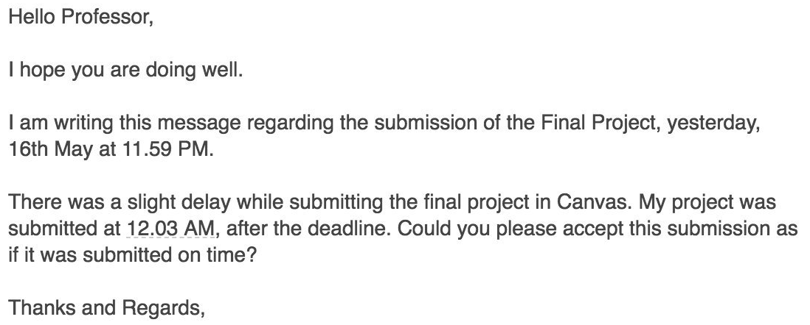
LATE IS LATE

Slide 22
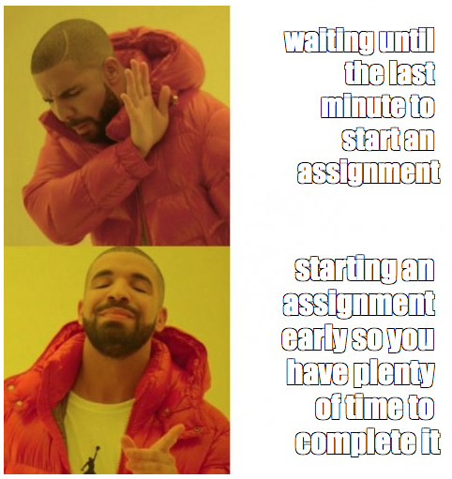

Slide 23
Grade Disputes
I have on (rare) occasions been known to make mistakes.
If you spot an mistake in your grades then contact me and we’ll get it resolved.
Note that if I review an assignment for grading mistakes I will conduct a complete regrade, your resulting grade may be higher or lower.

Slide 24
Notice
If you didn’t do the assignment, admit it.
If you submitted the assignment late, admit it.
If you don’t understand the assignment, ask for help.
If you didn’t study or put any effort into the assignment accept the grade and resolve to do better (with my help if needed) next time.

Slide 25
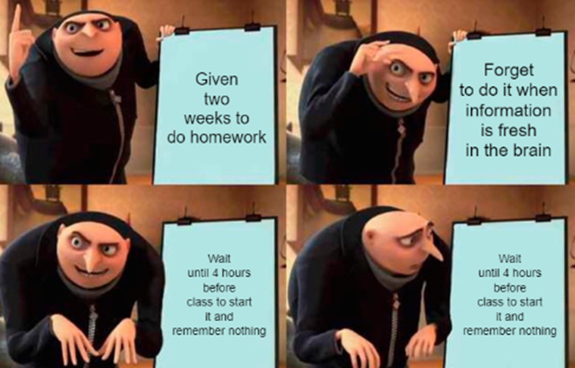
Homework
There are 5 homework assignments. You will be given at least 2 weeks to complete each assignment. That is 336 hours (14x24).
Due dates for the homework are in the syllabus & Canvas.

Slide 26
Midterm and Final Projects
This class has a projects vs exams.
Treat the midterm as if you are presenting it to a
C-level technical executive. (CIO, CISO, CTO, …).
Treat the final as if you are presenting it to senior level technical staff member (security architect, system architect, …).
You will be given at least 3 weeks to complete each project. THAT IS 504 HOURS (221x24).

Slide 27
Academic Integrity
The University of Maryland, College Park has a nationally recognized Code of Academic Integrity. This Code sets standards for academic integrity at Maryland for all undergraduate and graduate students. As a student you are responsible for upholding these standards for this course. It is very important for you to be aware of the consequences of cheating, fabrication, facilitation, and plagiarism. For more information on the Code of Academic Integrity or the Student Honor Council, please visit https://studentconduct.umd.edu/

Slide 28
Honor Pledge
All assignments and exams for this course are governed by the Honor Pledge: “I pledge on my honor that I have not given or received any unauthorized assistance on this exam/assignment.”

Slide 29
Plagiarism
DON’T
DO
IT

Slide 30
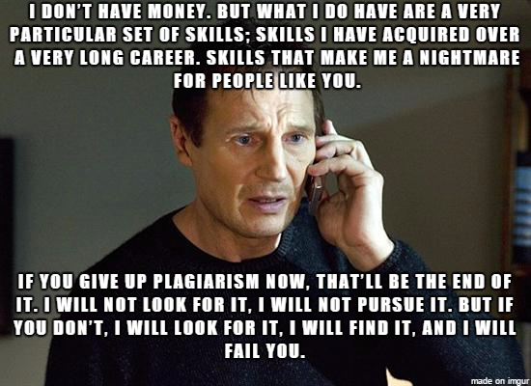

Slide 31
Asking for help
Asking a fellow student for help understanding a concept is OK
Asking a student to help you with an answer to a homework assignment or project IS NOT OK.
If you are asked for answers to an assignment DO NOT provide them.
If you need help with a concept or how to do something ASK!
Email the TA or the instructor
Attend office hours (virtually or in person)

Slide 32
Plagiarism. Don’t do it.
The practice of taking someone else's work or ideas and passing them off as one's own.
This includes getting a friend/classmate to give you the answers to an assignment and using them.
Helpful infographic: http://thevisualcommunicationguy.com/wp-content/uploads/2014/09/Infographic_Did-I-Plagiarize1.jpg
If I see it you will get a 0 for the assignment and at my discretion will be reported to the Office of Student Conduct.
Seriously.
Don’t be that person.
Seriously.

Slide 33
Which one is correct?
ip address
IP address
Ip address
I.p. address
I.P. address

Slide 34
PROOFREAD YOUR WORK
If I find typos or egregious grammatical errors in your work I will subtract points.
Example: When I see a sentence that goes on and on, I mean absolutely no end in sight, this sentence is just a beast, plot twists, changes in scenery, hell by the end of it I am not even sure where it began, maybe something about apples, anyway plz use the correct punctuation, spellchek yur werds and write in complete thoug.

Slide 35
PROOFREAD YOUR WORK
I am preparing you for taking the next step in the real world and part of that is projecting that you know what you are talking about.
Typos and grammatical errors do not inspire competence.

Slide 36
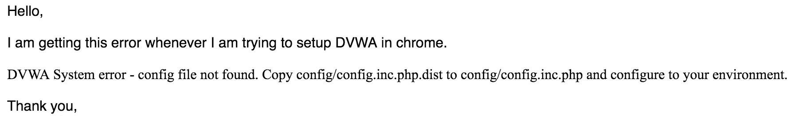
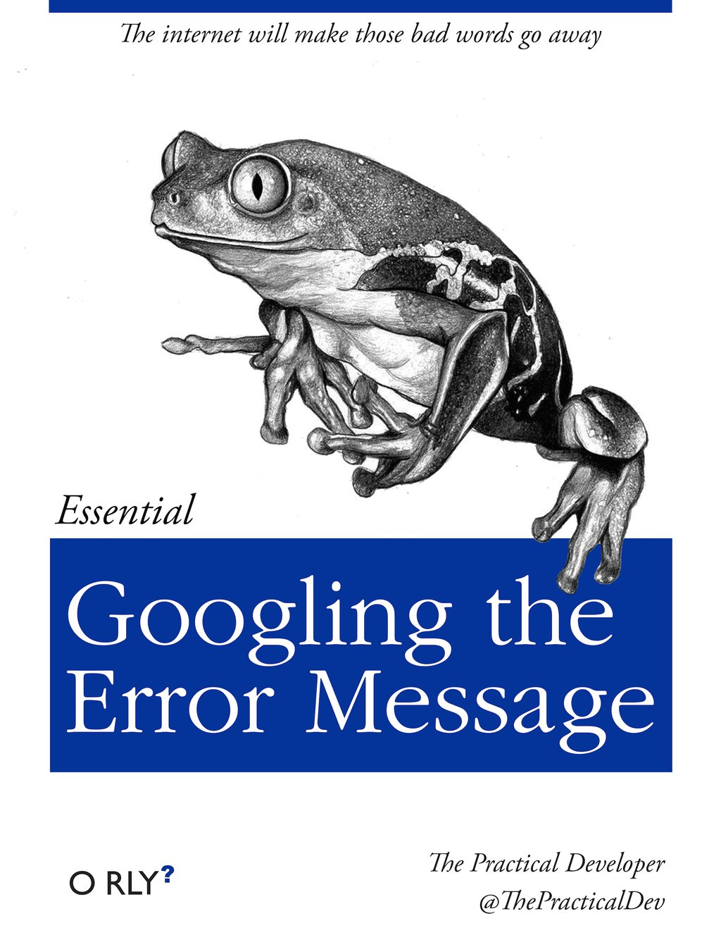
Troubleshooting

Slide 37
Course Layout
Week of Sept 1 - Introduction, Administrivia, and Securing the Cloud
Week of Sept 8 – Securing the Cloud – IaaS, PaaS, SaaS
Week of Sept 15 – I will be traveling but there will be a recorded class in Canvas on Designing and Redesigning Secure Applications for the Cloud (pre-recorded class)
Week of Sept 22 - Identity and Access Management
Week of Sept 29 – Protecting Data

Slide 38
Course Layout
Week of Oct 6 – Compliance in the Cloud
Week of Oct 13 – Deep Dive – AWS
Week of Oct 20 – NO CLASS – Work on midterm project
Week of Oct 27 – Deep Dive – Azure
Week of Nov 3 – Deep Dive – Google Cloud Platform

Slide 39
Course Layout
Week of Nov 10 – Incident Response in the Cloud
Week of Nov 17 – Vulnerability Scanning and Pen Testing in the Cloud
Week of Nov 24 – NO CLASS – Thanksgiving Break
Week of Dec 1– Deep Dive Securing SaaS Apps
Week of Dec 8 – Course Wrap up

Slide 40
Feedback is a Gift
Please let me know if you find something lacking or have specific tools you’d like to see included.
Don’t be afraid to share your honest opinion
Feedback should be specific
Feedback should be descriptive
Feedback should be timely

Slide 41
Class Requirements
A computer with a web browser, command prompt, and Internet access.
An AWS account
The AWS CLI tool
An Azure account

Slide 42
Set aside $50
The work we do during the in class exercises, homework, and projects should be able to be done in the free tiers of AWS, Azure and Google.
That said you should set aside $50 for potential overages.
ALWAYS SHUT OFF CLOUD SERVICES WHEN DONE!

Slide 43
CCSP
Certified Cloud Security Professional
This class is not a CCSP-prep class, but the class material is aligned with it.

Slide 44

CCSP Book
(ISC²) Official Study Guide
O’Hara, B. & Malisow, B. CCSP (ISC)2 Certified Cloud Security Professional Official Study Guide 2nd edition Sybex, 2019. ISBN: 978-1119603375

Slide 45
Technical Issues
With ELMS: elms@umd.edu
With the recorded lectures: dets-support@umd.edu or http://www.dets.umd.edu/
Tools discussed in class:
Google
AWS/Azure/GCP documentation
Email the TA
Email the Professor

Slide 46
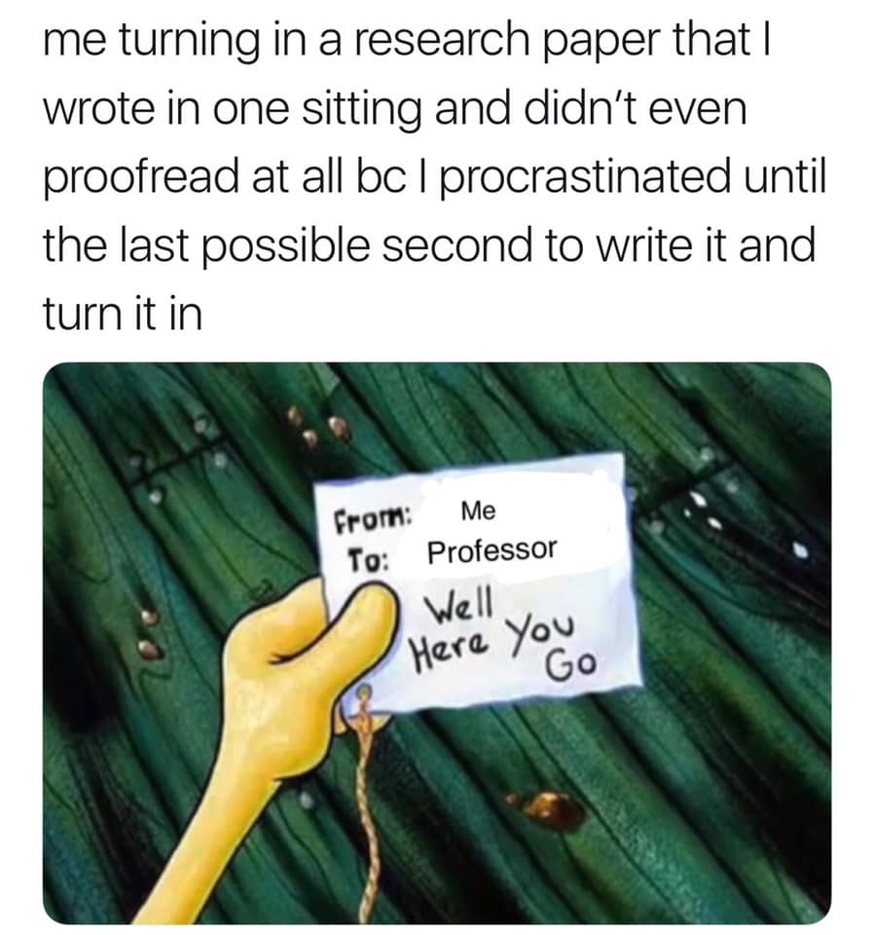
Time Management 101

Slide 47
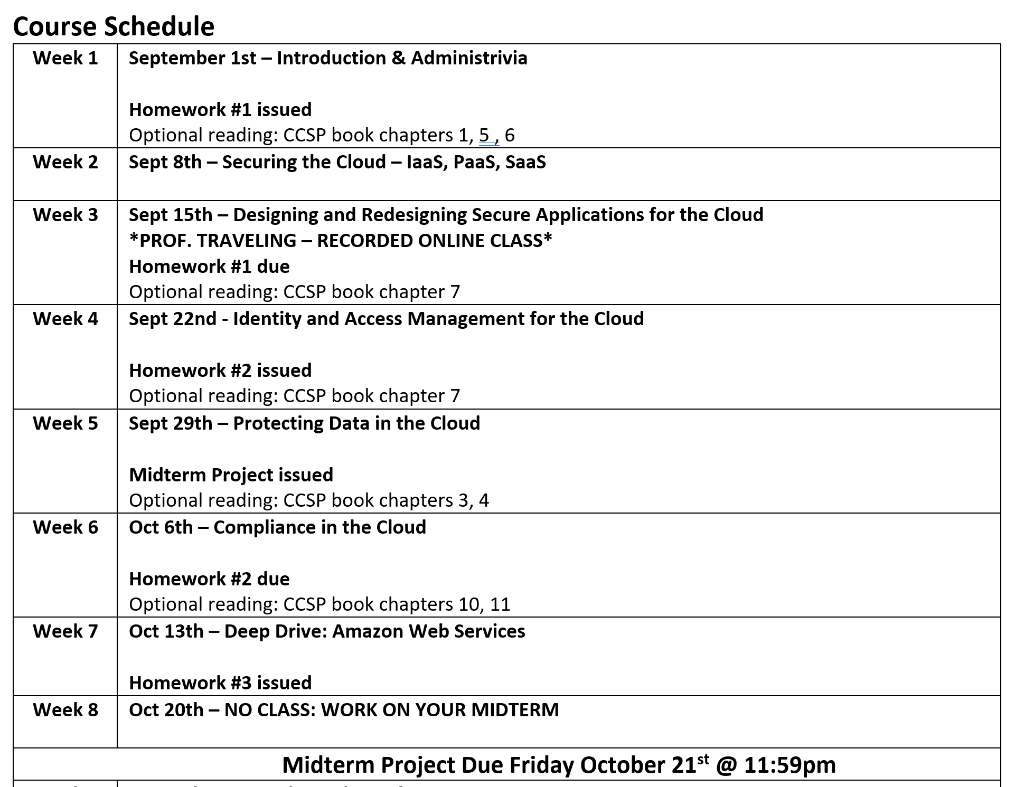

Slide 48
Build your calendar
9/15 – HW #1 due
10/6 – HW #2 due
10/21 – Midterm due
11/3 – HW #3 due
11/17 – HW #4 due
12/1 – HW #5 due
12/16 – Final due

Slide 49
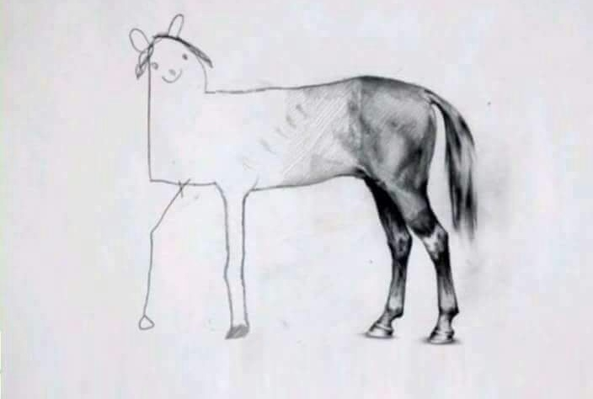
Don’t let your assignments look like this

Slide 50
Time Management
You have at least 2 weeks to complete an assignment
Night of – review the assignment – how much time will this take me? The professor has included a time estimate, how close is that for me?
Day after class – begin/complete assignment
2 Nights before it’s due – review/upload assignment

Slide 51
How I’d do a project
Midterm assigned 9/29
Review and begin work 9/30 – 10/2
Develop outline
Draft complete 10/5 – 10/18
Completed, night off for review 10/19
Review & Submit midterm – 10/20
Midterm due 10/21 @ 11:59pm

Slide 52
Why?
Completed, night off for review 10/19
Review & Submit midterm – 10/20
Midterm due 10/21 @ 11:59pm
Why?

Slide 53
Every semester
Review the syllabi for your classes for assignments, exams, projects, etc. and put them on your calendar!
If a syllabus doesn’t list assignments/dates then ask the professor!

Slide 54
So what is
“the cloud”?

Slide 56
What is the Cloud?
Essentially someone else’s computer that you lease from them.

Slide 57
What is the Cloud?
Essentially someone else’s computer virtual machine that you lease from them.

Slide 58
What is the Cloud?
Essentially someone else’s computer virtual machine infrastructure that you lease from them.

Slide 59
What is the Cloud?
Essentially someone else’s computer virtual machine elastic infrastructure that you lease from them.

Slide 60
NIST 800-145 Definition of Cloud
“Cloud Computing is a model for enabling ubiquitous, convenient, on-demand network access to a shared pool of configurable computing resources (e.g. networks, servers, storage, applications, and services) that can be rapidly provisioned and released with minimal management effort or service provider interaction.”
http://nvlpubs.nist.gov/nistpubs/Legacy/SP/nistspecialpublication800-145.pdf

Slide 61
In the 90s/00s…
We had web hosting companies and application hosting companies.
“Why build a data center when we can do it for you?”
But the Application Service Provider still had to provision hardware and spin it up…

Slide 62
ASP + API = Cloud
Let’s add an Application Programming Interface (and UI) to application service providers and make ALL THE MONEY.
Click button, get server.
Add elasticity so you can scale up and down on demand and only pay for what you use.

Slide 63
Everything as a Service
Software as a Service (think Google Apps, Salesforce, Box)
Platform as a Service (think Salesforce, AWS Elastic Beanstalk)
You manage the application, provider manages the underlying infrastructure.)
Infrastructure as a Service (think AWS, Azure, Google Cloud Platform)

Slide 64
5 attributes of cloud computing
Multitenancy - You’re sharing the real hardware with many other people/companies
Elasticity - Need 5 systems or 5 Million systems? We got that
Pay as you go - No long term contracts* or capital expenses
Self-provisioning of resources - Click button, get server
Massive scalability - You get a data center in VA, you get a data center in Europe, you get a data center in Singapore…

Slide 65
Software-as-a-Service
Instead of buying a software package you lease it, pay as you go.
This puts it as an operating expense and not a capital expense.
CIOs and money people like that.

Slide 66
Other benefits
(In theory) Save on expenses of
Licensing
Servers
Storage
Network Infrastructure
People to manage system

Slide 67
Platform-as-a-Service
You are given a development platform to build applications on top of
Typically provided toolkits and standards for development and then the sky is the limit.
Think Salesforce

Slide 68
Salesforce
Started as an SaaS customer relationship management tool (because in house ones are $$$ and often fail to be implemented successfully.)
Expanded to offer a full suite of apps like Support/Trouble ticketing, HR issues, performance improvement/coaching, and tons more.
Plus anyone can write an app that runs on Salesforce.

Slide 69
Infrastructure-as-a-Service
Essentially a vendor provides you with virtual systems that you can install any software, OS, etc. you want and do with it as you please (within the Terms of Service)

Slide 70
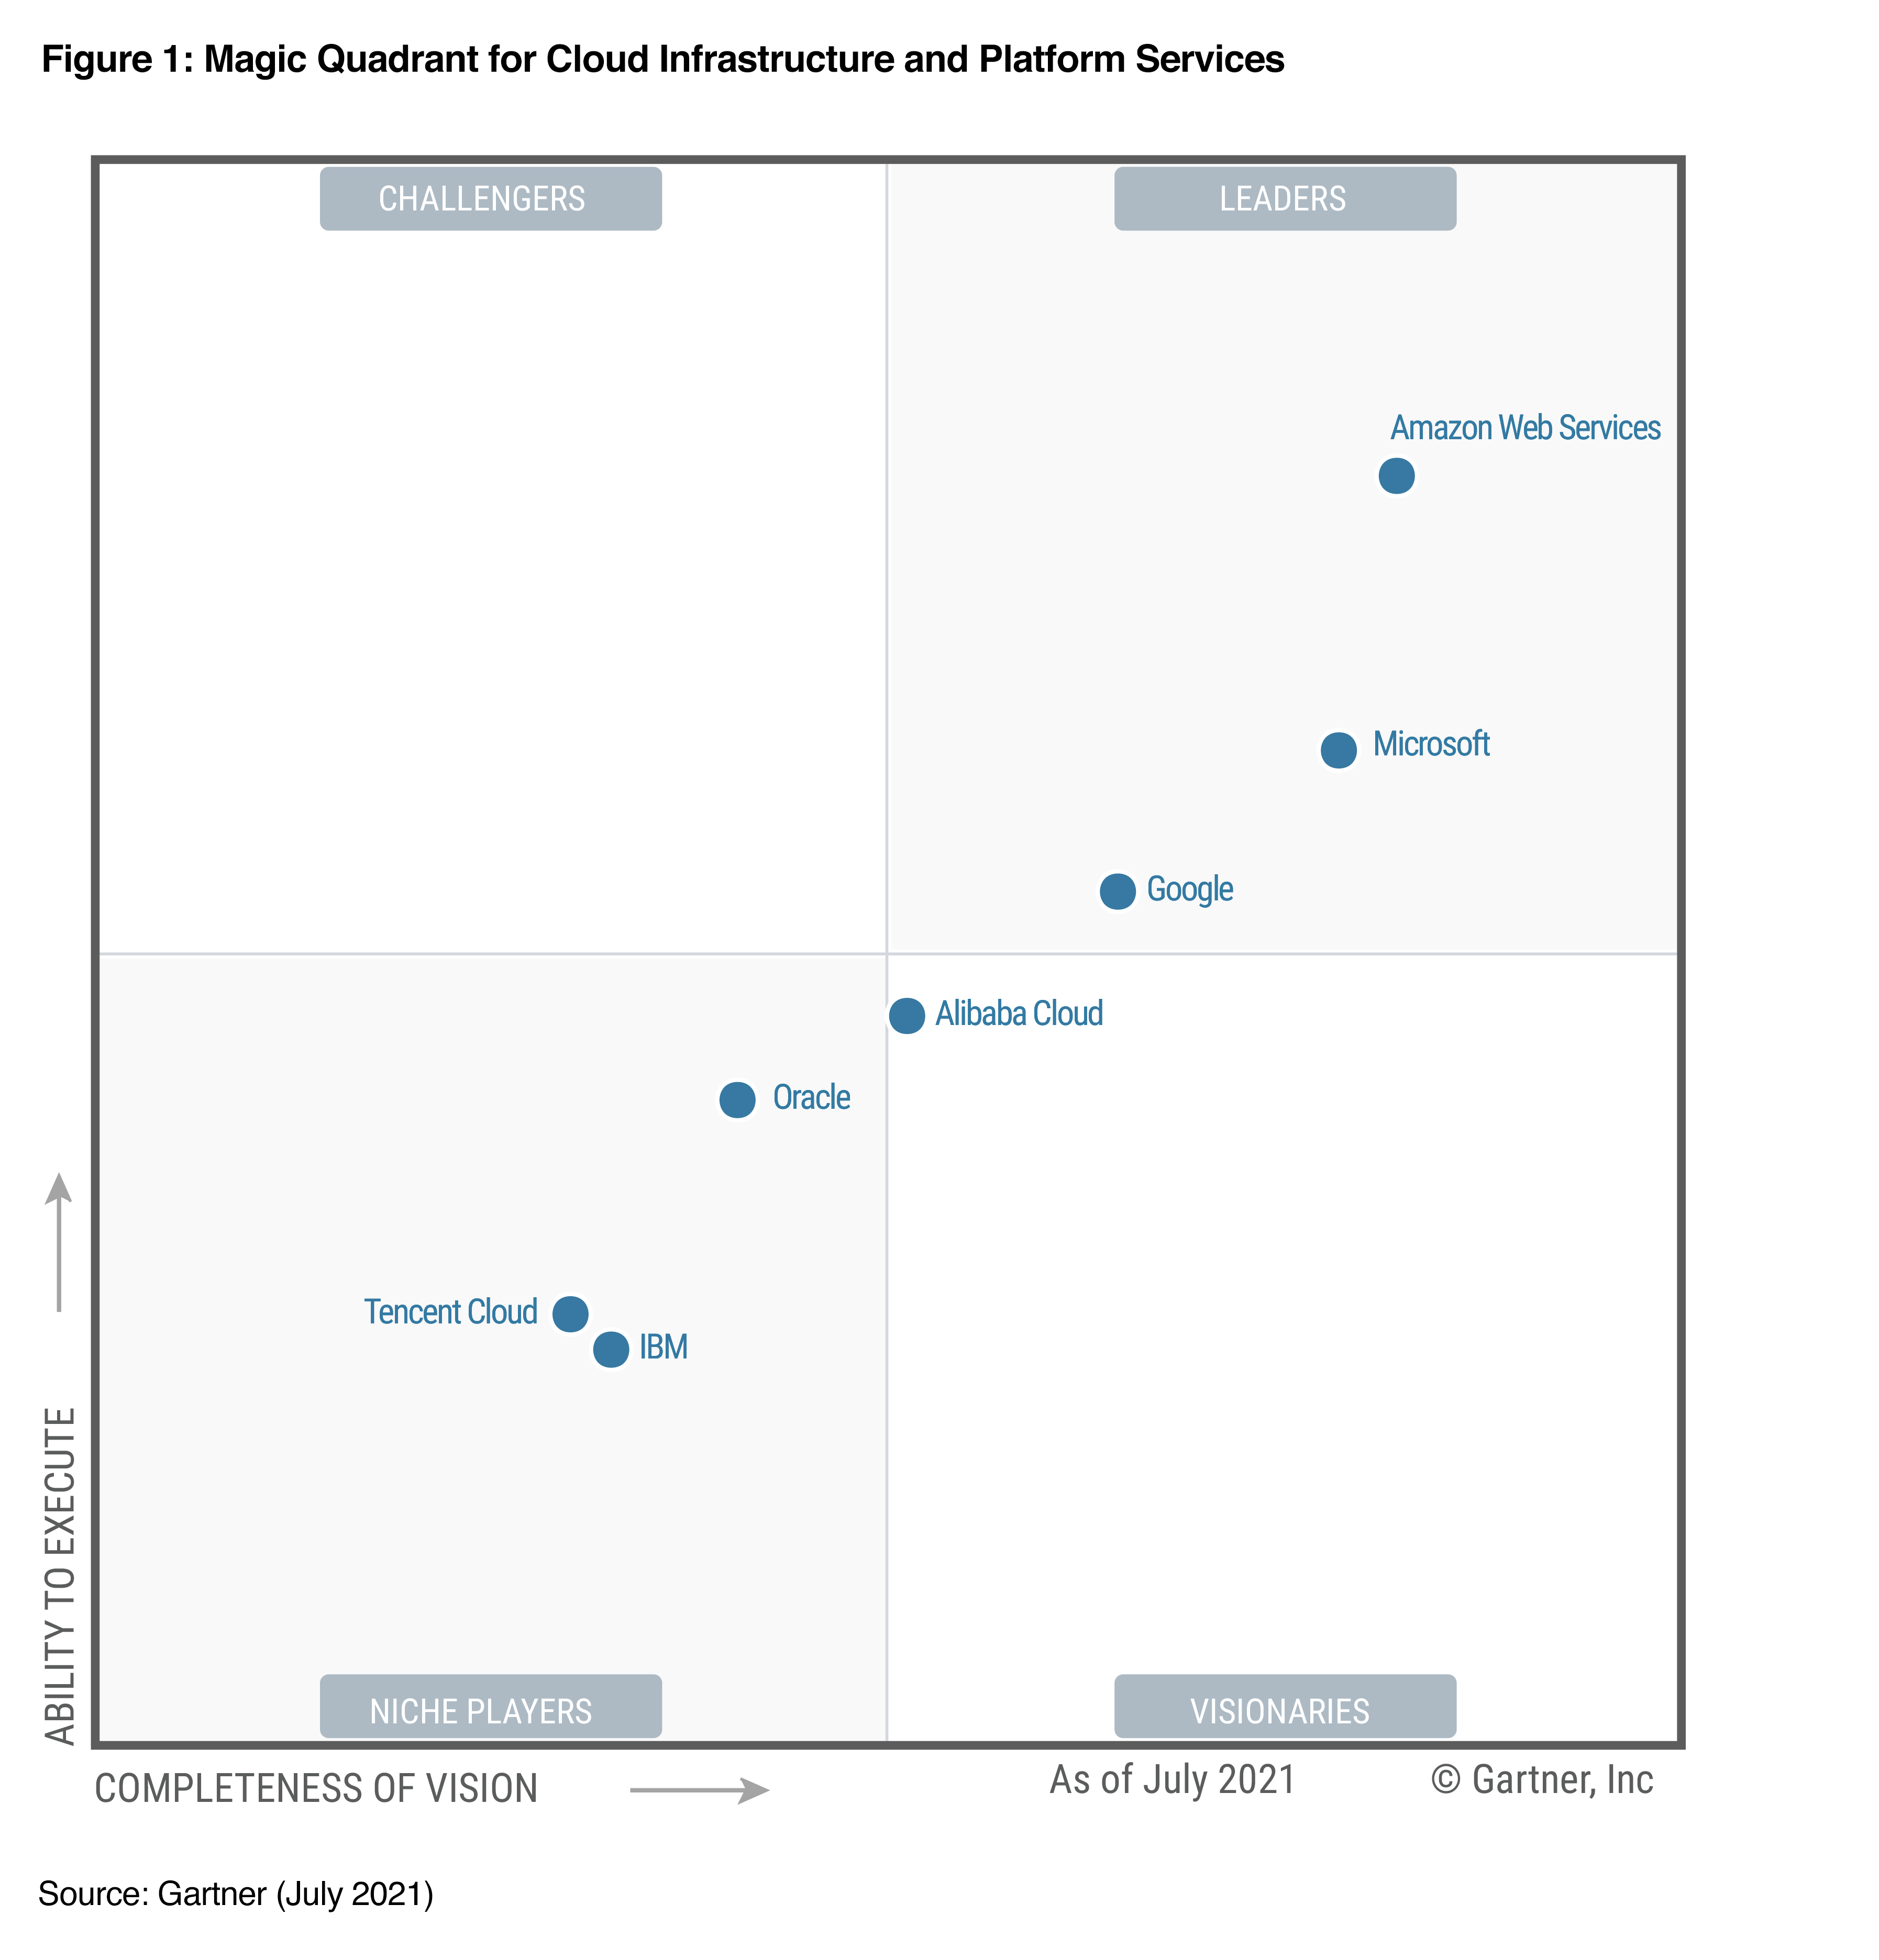
IaaS Players

Slide 71
Cloud Models
Public
Private
Hybrid
Community

Slide 72
Public Cloud
A vendor offers up their computing environment to any one (the public) to use.

Slide 73
Private Cloud
An internal-to-the-organization computing environment that can be used by the organization and their customers. Similar to a traditional IT organization but usually with some automation.

Slide 74
Hybrid Cloud
A mix of 2 or more cloud types.
Ex: private cloud for most uses but on demand spikes to a public cloud vendor
Or public cloud for public facing web app, private cloud for sensitive internal research

Slide 75
Community Cloud
Infrastructure is provided by an affinity group, different pieces owned by different organizations/people but for ”the common good.”
Ex: Gaming network
Gaming Co maintains IAM, companies/individuals maintain gaming servers, end users processing on their systems

Slide 76
Community Cloud
Ex: A college conference
The conference made up of a number of schools pool their resources to build a “cloud” environment
Economy of scale

Slide 77
Community Cloud
* I think this is a stretch but CCSP (and CISSP) books talk about it so it’s wise to know it is there.
In most environments all you’ll deal with is public, private, and hybrid.

Slide 78
Benefits of the Cloud
Reducing capital expenses
Reducing personal costs
Reducing operational costs
Transferring (some) regulatory costs

Slide 79
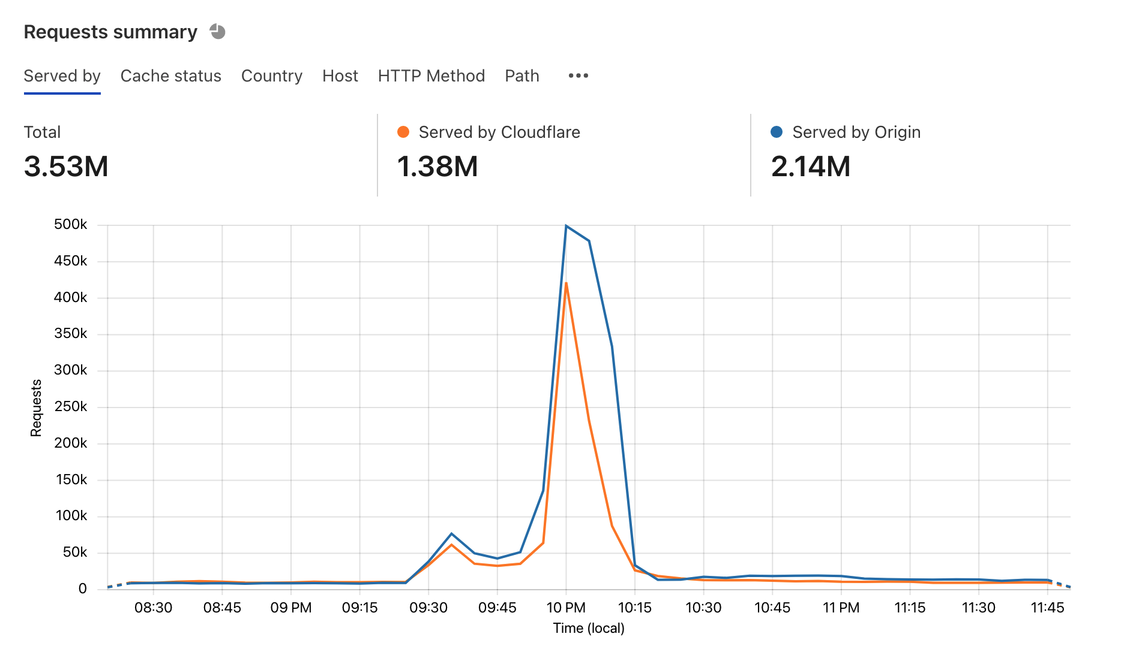
Reducing capital expenses
No need to purchase systems, network gear, racks, buildings, etc. to cover your peak usage (that may only happen once a year for a few days and the rest of the time is idle)

Slide 80
Reducing personal costs
Less on-prem systems = less IT people needed on-prem *
* IN THEORY

Slide 81
Reducing operational costs
Costs are lumped in with the flat-rate cost of the cloud contract so no longer have to plan for unexpected costs related to:
Scheduled updates
Emergency response

Slide 82
Transferring (some) regulatory costs
Cloud provider may offer services/systems that meet regulatory compliance (PCI, FedRAMP, etc)
Provider has set of controls that offer a turn key solution to your cloud environment.
Risk/liability is still not transferred, you’re still on the hook for PII breaches

Slide 83
Remember
If there is a breach of your cloud environment and PII is disclosed your company is the one that will be getting the bad PR, not the cloud provider.

Slide 84
Core Concepts of Cloud
Virtualization
Sensitive Data
Encryption
Auditing and Compliance

Slide 85
Virtualization
Virtualization is what makes the cloud work and makes it economically viable.
It allows providers to deploy physical systems and allow customers to use part of them (virtually) without an extended spin up/down process.
To the user there is no difference between a physical and a virtual system.

Slide 86
Virtualization
To the provider a VM is just a file, multiple VMs can run on a physical server and they are isolated from one another.
Many different options here – VMWare, Hyper V (Azure), KVM (AWS), Zen (AWS)

Slide 87
Sensitive Data
Every organization has their own risk tolerance and desires confidentiality.
Cloud provider should offer options to allow customer to categorize their data by sensitivity and provide controls to protect said data.

Slide 88
Encryption
Offers customers some assurance that only properly authorized people can access their data. This can be visible or invisible to the user (if invisible noted in a contract or Service Organizations report – Controls (SOC)-II report.)
This applies to data at rest and data in transit.
This is still often left to the customer to perform.

Slide 89
Auditing and Compliance
Allowing the customer to log every action in their environment so they can audit their use and access to data is key.
Going to a provider’s physical location for an audit is pretty much impossible. Industry standard methods to demonstration compliance by the provider (ex SOC-II Type 2 or SOC-III reports) are needed here.

Slide 90
Auditing and Compliance
Complying with regulatory requirements (PCI DSS, GLBA, HIPAA, etc) is really hard. Providers who can offer a solution to compliance requirements in an easy to use method with a tested control set and procedures will be very popular.

Slide 91
Homework #1
Create an AWS account
Setup up the AWS CLI tool and configure it to be used with your AWS account
*Tell me about you assignment – no points but I get to know you!*

Slide 92
Reminder
I do not have any open TA/GA/grader/student employee positions at this time.
If and when I do they will be posted on MAGE’s website and/or I will post about them in ELMS.

